Slide 1
Android Security Overview

Slide 2
Overview
High level summary
Look at code

Slide 3
SELinux
Used since Android 4.3
Mandatory Access Control (even to root processes)
https://source.android.com/devices/tech/security/selinux/

Slide 4
Android Permissions
Each package gets a separate UID
  ls -l /data/data

Slide 5
Android Permissions
Explicit permissions
<manifest xmlns:android="http://schemas.android.com/apk/res/android"
package="com.android.app.myapp" >
<uses-permission android:name="android.permission.RECEIVE_SMS" />
...
</manifest>
http://developer.android.com/guide/topics/security/permissions.html

Slide 6
Android API calls
App calls public API in library
Library is just a proxy that makes RPC to system process
ClipboardManager mClipboard = (ClipboardManager) getSystemService(Context.CLIPBOARD_SERVICE);
mClipboard.getPrimaryClip();
ClipboardManager → IClipboard$Stub$Proxy → Binder → ClipboardService

Slide 7
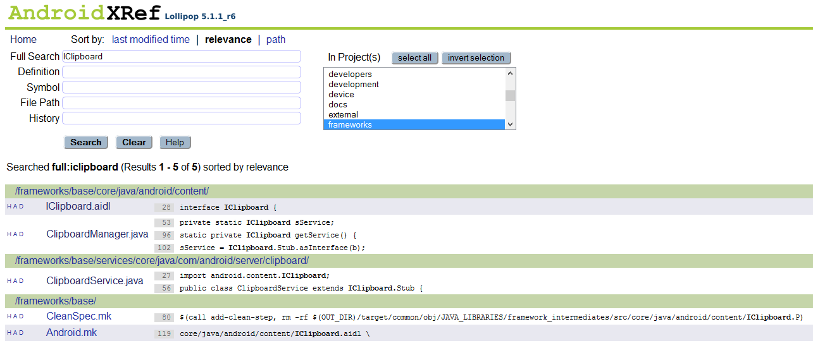
Looking at Android source code
Notes:
http://androidxref.com/5.1.1_r6/search?q=IClipboard&defs=&refs=&path=&hist=&project=frameworks

Slide 8
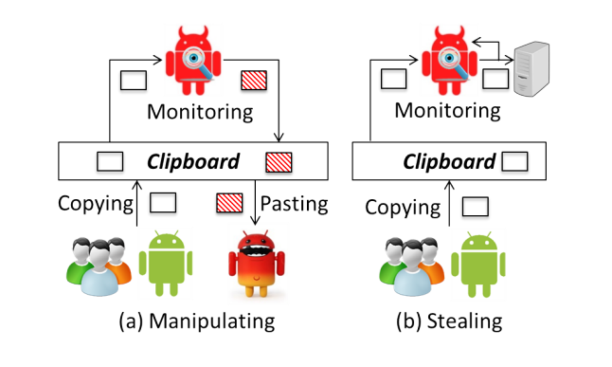
Clipboard is vulnerable
Attacks on Android Clipboard (Zhang and Du, 2014)
http://www.cis.syr.edu/~wedu/Research/paper/clipboard_attack_dimva2014.pdf

Slide 9
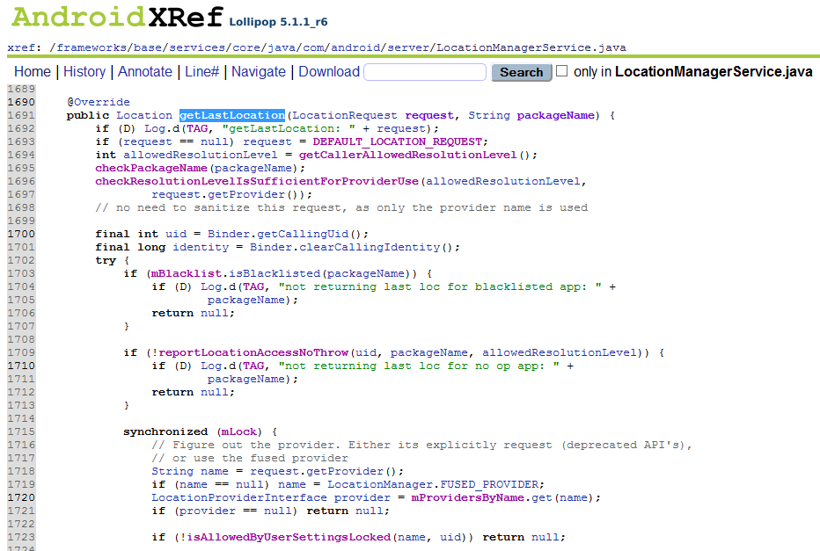
Checking for permissions

Slide 10
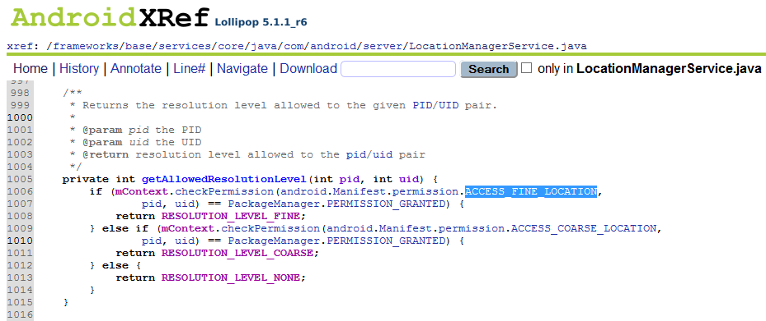
Permission check

Slide 11
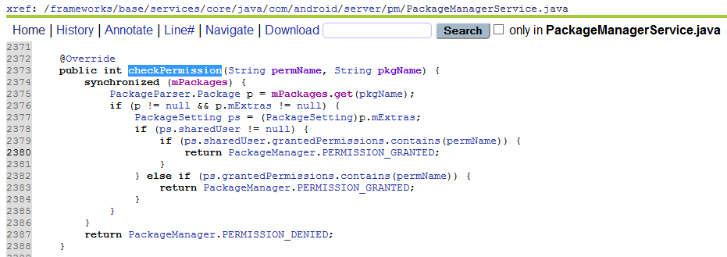

Slide 12
Strategies
Instrument package manager permission checks
Create new permissions at system level
  http://stackoverflow.com/questions/14887948/android-create-new-system-permission-in-through-aosp-source-code
Add custom app permissions
  <uses-permission>
Disassemble APK to smali and look at API usage
Native? Use systrace

Slide 13
Project needs
Good Linux system (8 or more cores, SSD, 16 GB RAM or more )
Nexus 5 or 6

